Slide 1
LN RFID process
Miika Vaarasuo
9.9.2022

Slide 2
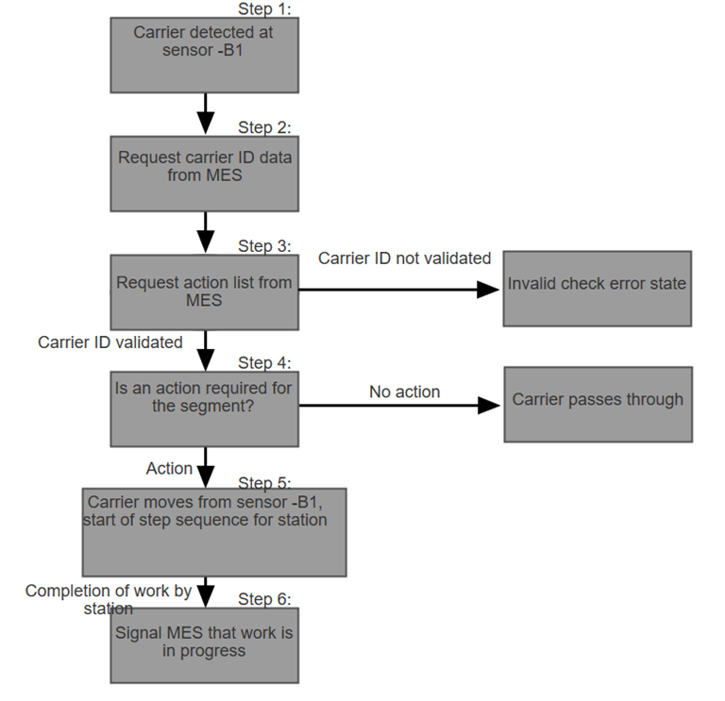
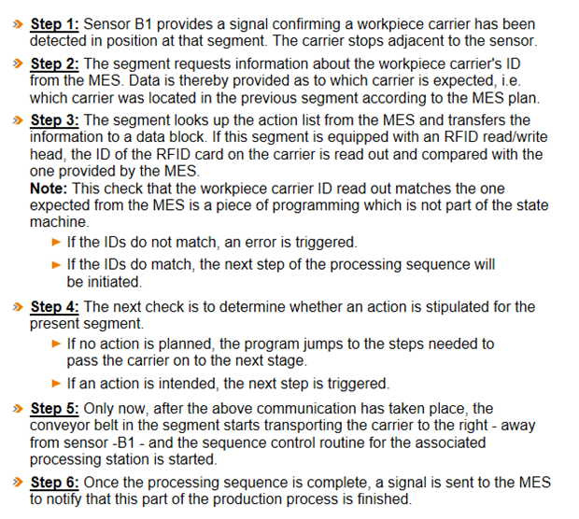

Slide 3
Step1
Carrier detected at sensor –B1
Step2
Request carrier ID data from MES
Step3
Request action list from MES
Carrier ID validated -> Step4
Action -> Step5
Completion of work by station -> Step6
Signal MES that work is in progress
Is an action required for the segment?
Carrier moves from sensor –B1, start of step sequence for station
Carrier ID not validated
Invalid check error state
No Action
Invalid check error state

Slide 4
Step1: Sensor –B1 provides a signal confirming a workpiece carrier has been detected in position at the segment. The carrier stops adjacent to the sensor.
Step2: The segment requests information about the workpiece carrier’s ID from the MES. Data is thereby provided as to which carrier is expected, i.e. which carrier was located in the previous segment according to the MES plan.
Step3: The segment looks up the action list from the MES and transfers the information to a data block. If this segment is equipped with an RFID read/write head, the ID of the RFID card on the carrier is read out and compared with the one provided by the MES

Slide 5
Note: This check that the workpiece carrier read out matches the one expected from the MES is a piece of programming which is not part of the state machine.
  If the IDs do not match, an error is triggered.
  If the IDs do match, the next step of processing sequence will be initiaded.
Step4. The next check is to determine whether an action is stipulated for the present segment.
If no action is planned, the program jumps to the steps needed to pass the carrier on to the next stage.
If an action is intended, the next step is triggered.

Slide 6
Step5 : Only now after the above communication has taken place, the conveyor belt in the segment starts transporting the carrier to the right – away from sensor –B1 and the sequence control routine for the associated processing station is started.
Step6: Once the processing sequence is complete, a signal has sent to the MES to notify that this part of the production process is finished

