Slide 1
IO Link with IFM and TIA portal

Slide 2
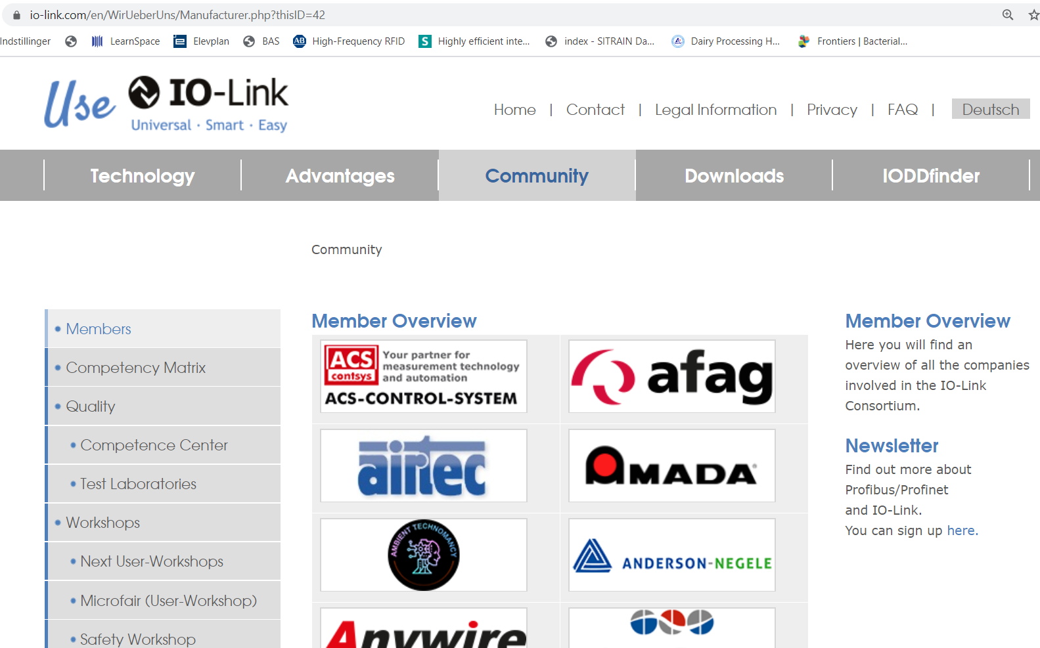
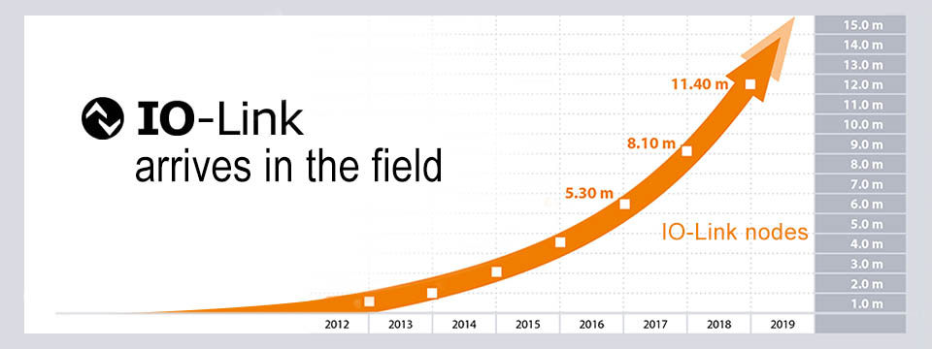
IO Link
What it is
IO Link is an open international standard (IEC 61131-9)
It is marketed and controlled from this website.
I/O Link is a relatively new standard, which has experienced rapid growth in recent years.

Slide 3
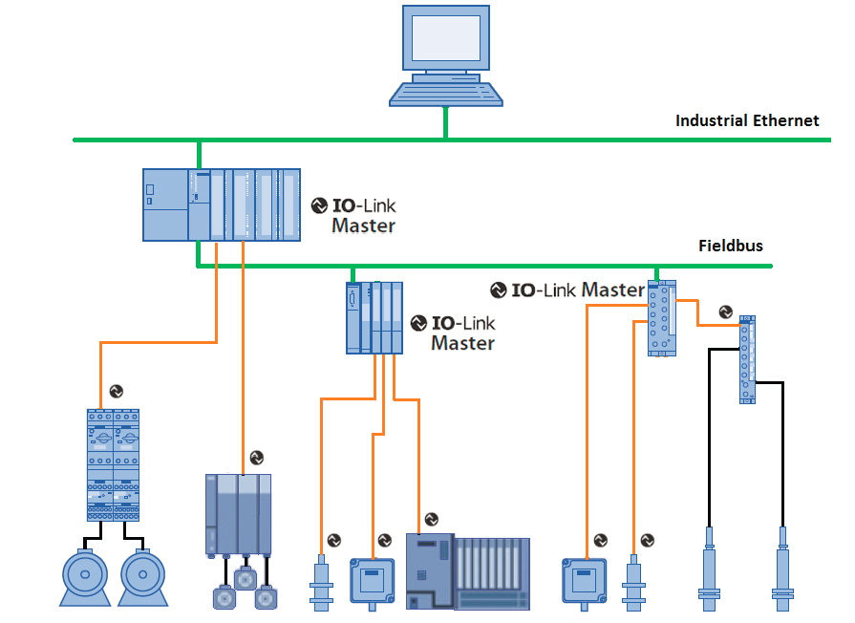
IO Link
What it is
IO Link is not a network, but point-to-point communication.
half duplex
Two-way data exchange
3 communication speeds:
COM 1 = 4.8 kbaud
COM 2 = 38.4 kbaud
COM 3 = 230.4 kbaud
An IO master module controls communication with the slaves / IO devices
The master module can communicate to PLC via various fieldbus standards.
These are shown below
IO-Link Device

Slide 4
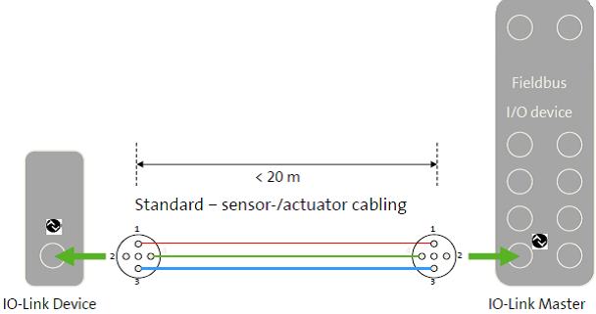
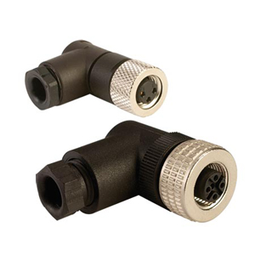
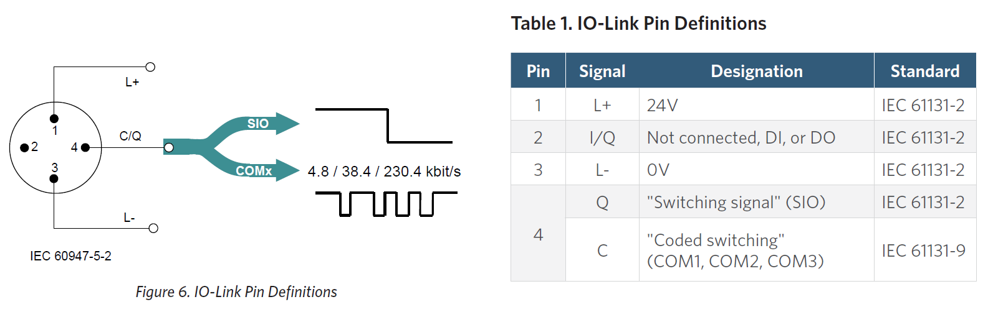
IO Link
Electrical connection
Typical 3-wire cable 0.34mm2 without screen max. 20 m.
connection with M5, M8 or M12 standard connectors.
SIO Standard I/O mode (on/off)
COMx IO Link communication

Slide 5
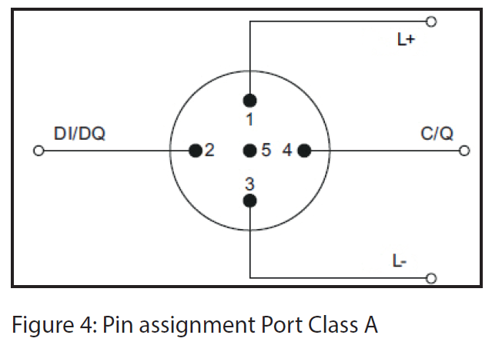
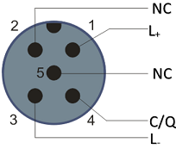
IO Link
Electrical connection
Port Class A (Type A)
The features of pin 2 and 5 are not specified.
The manufacturer can define the function of these Pins themselves.
Pin 2 is usually used for an additional digital channel.

Slide 6
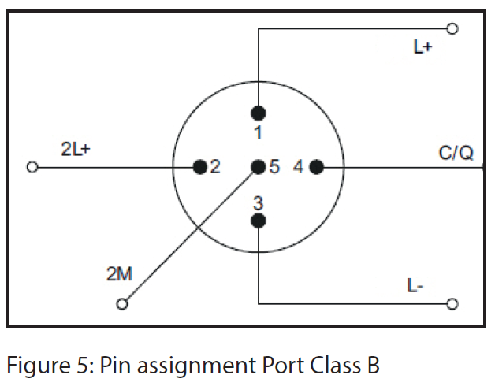
IO Link
Electrical connection
Port Class B (Type B)
Allows for additional voltage supply and is suitable when connecting devices that have a higher power consumption.
In this case, pins 2 and 5 are used to provide an additional galvanically insulated supply voltage.
A standard 5-wire cable is required to use this additional supply voltage.

Slide 7
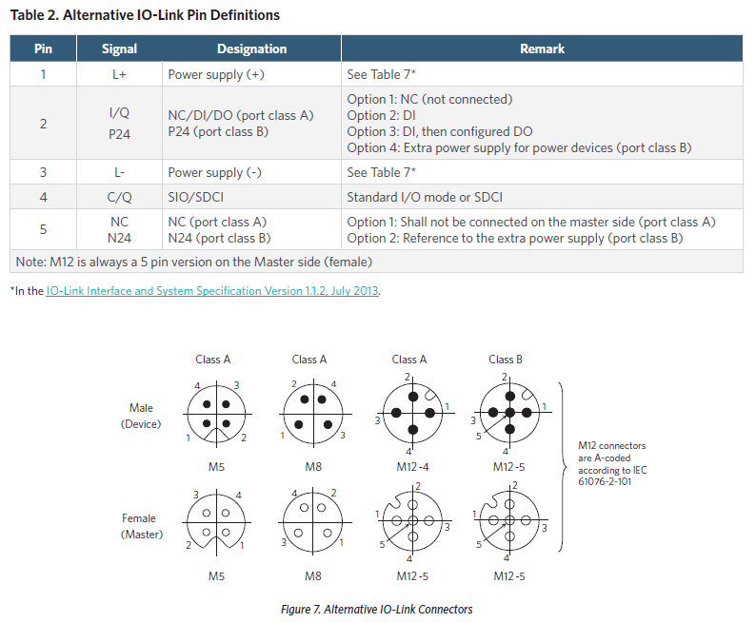
IO Link
Electrical connection
The supply range in an IO-Link system is 20V - 30V for the master.
18V - 30V for the device (sensor or actuator).
A rising IO-Link signal must be above 13V to be registered as a "logic 1 signal.“
A falling IO-Link signal must be below 8V to be recorded as a "logic 0"

Slide 8
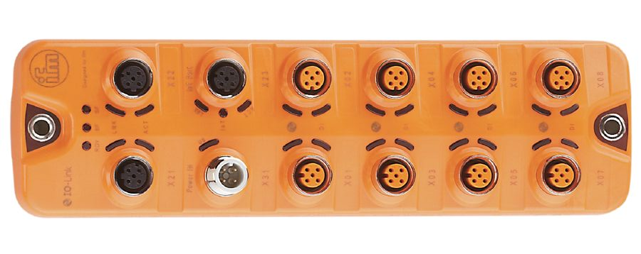
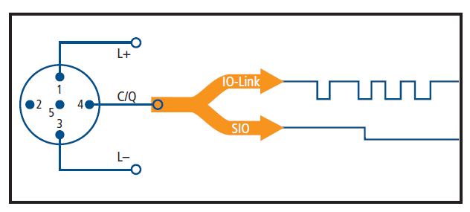
IO Link
Port operating modes/mode
The master's IO Link ports can be used in 4 modes:
IO-Link: In "IO-Link" mode, the port is used for IO-Link communication.
DI: In "DI" mode, the port behaves like a digital input.
DQ: In " DQ" mode, the port behaves like a digital output.
Disabled: "Disabled" mode can be used to disconnect unused ports.

Slide 9
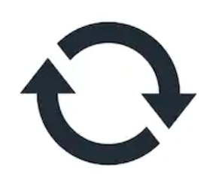
IO Link
Data exchange 4 forms
Continuous
• Process data → Cyclic data
I/O data, measurement values, etc.
Typically, 0 to 32 bytes of process data for each input and output. However, this is not locked and a manufacturer can choose a different solution.
• Value status → Cyclic data
Each port has a value status (PortQualifier) that indicates whether the process's data is valid or invalid.
• Device data → Acyclic data
Identification data and configurable diagnostic information.
• Events (event data) → Acyclic data
Events can be fault messages (e.g. short circuit) and warnings/maintenance data (e.g. fouling, overheating).
On request

Slide 10
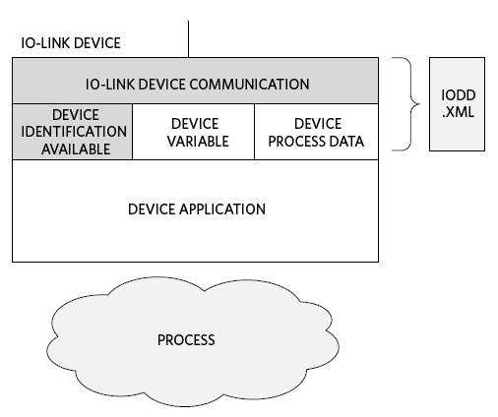
IO Link
IODD Files
All IO-Link devices (sensors or actuators) must have an IO-Link Device Description (IODD) file
This is used by the IO-Link master for identification, data interpretation and configuration.
What IODD contains:
- Data necessary for communication
- Device parameters
- Identification information
- Process and diagnostic information
- An image of the device and manufacturer's logo
IODD files are XML files
- The structure of IODD is outlined in the IEC 61131-9 standard.

Slide 11

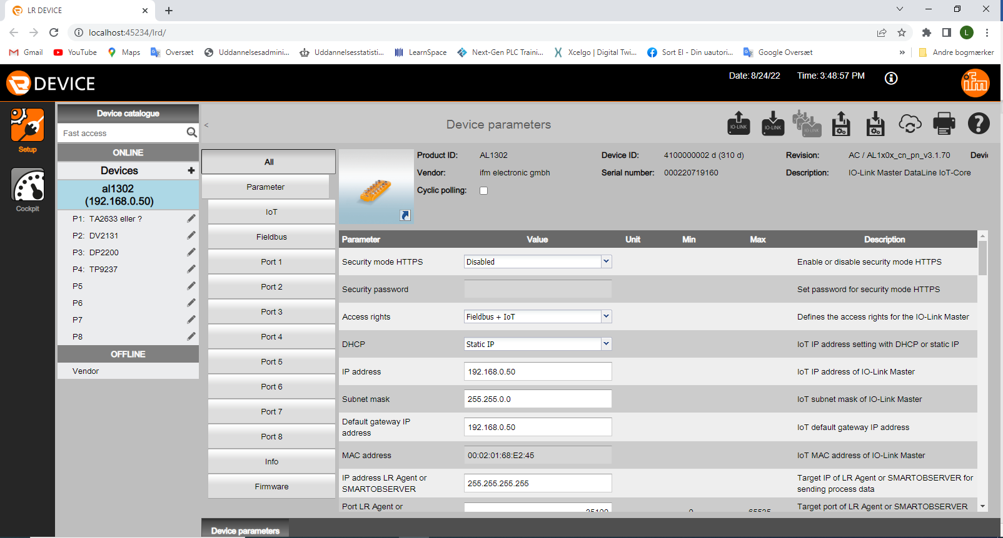
IO Link
IFM LR-DEVICE
IFM has developed a software LR-Device.
Setup is used for:
Changing setups on masts and connected device.
  Parameter
  IP-add.
  Naming.
Managing IODD files
  If devices from suppliers other than IFM are used, they are easily installed in LR-Device

Slide 12

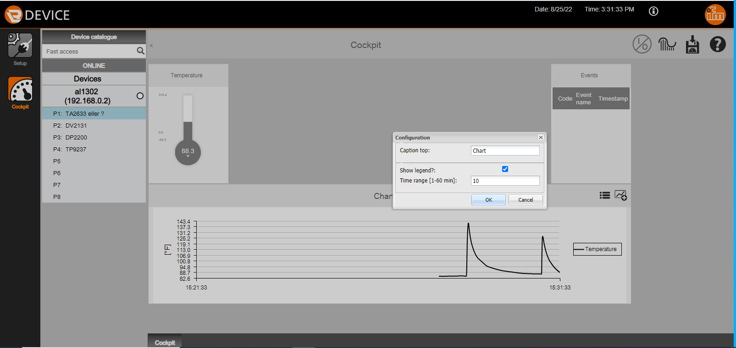
IO Link
IFM LR-DEVICE
IFM has developed a software LR-Device.
Cockpit is used for:
Displaying process values
Functional check
Debugging
Graph with history
Time axis can be set

Slide 13
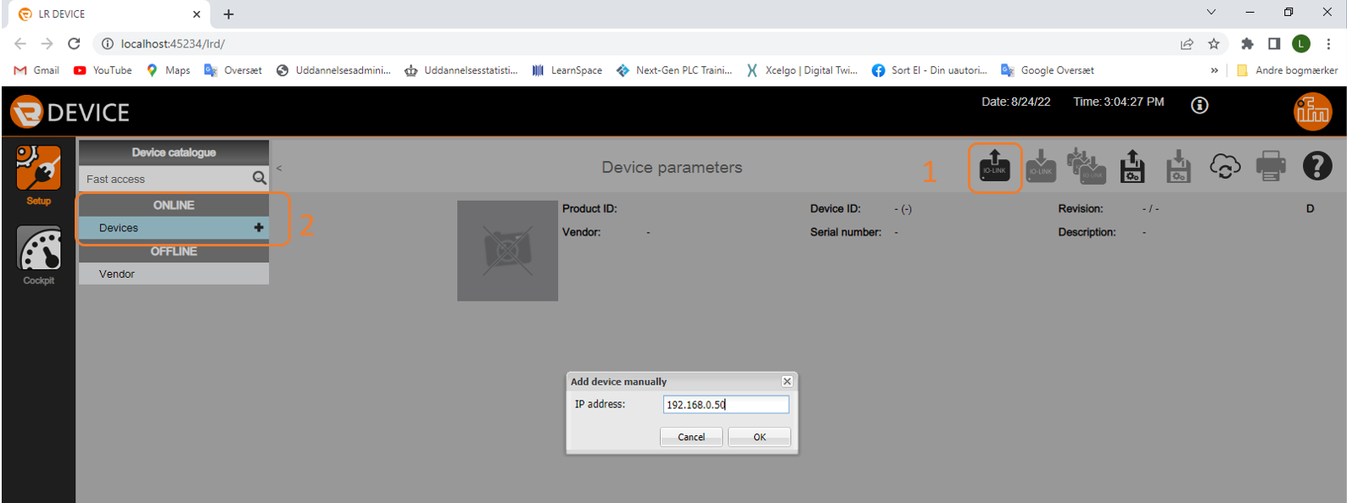
IO Link
IFM LR-DEVICE
B. Via IoT port
Communication with LR-DEVICE
Via a Profinet port
  Be careful not to interrupt Profinet
  Use only available ports
Via IOT port
  Does not disconnect networks
  More secure
LR-DEVICE auto scans the network for masters
  Doesn't it work then point 2
By pressing Device+, the IP add. on the master entered directly
A. Via Profinet

Slide 14
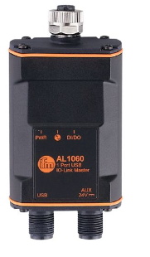
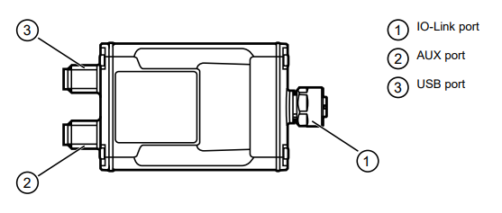
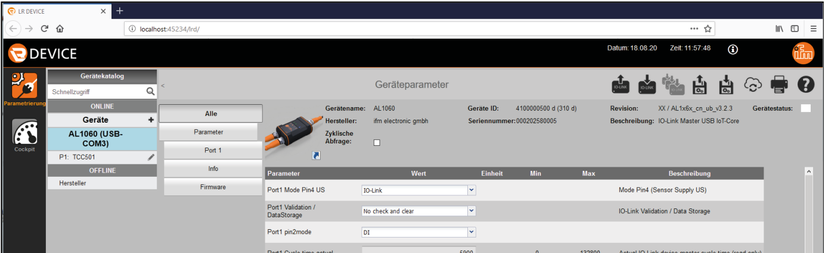
IO Link
IFM LR-DEVICE
Troubleshooting with LR-DEVICE
AL1060 is a great tool when troubleshooting
When sensor configuration

Slide 15
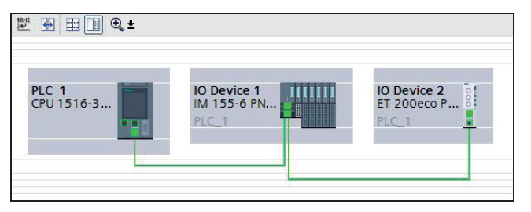
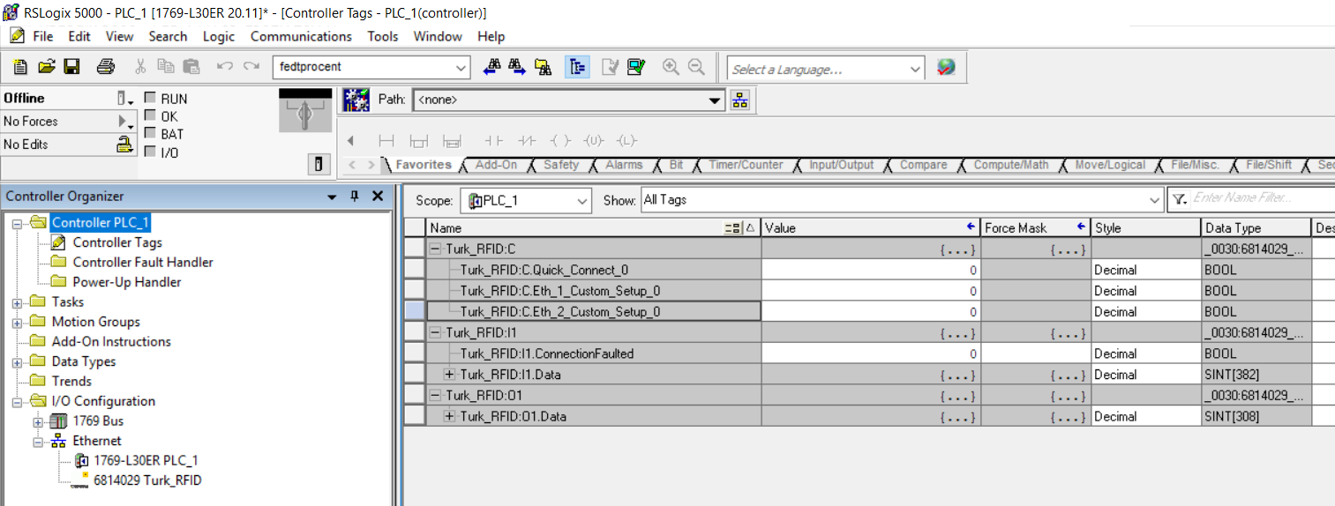
IO Link
GDS/EDS files
When an IO Link master module is to be connected to a PLC, it is typically done using a fieldbus system such as Profinet or EtherNet/IP.
In order for the PLC programming software to know what IO Link master system is being connected, a file with information must usually be installed in the PLC software.
These files are named for Profinet "GDSLM" and for EtherNet/IP "EDS".
Typically, these files can be downloaded from the website of the manufacturer of the IO Link master.
Configuration of a PROFINET network
with lower-level IO-Link masters
Configuration of a EtherNet/IP network
with lower-level IO-Link masters

Slide 16
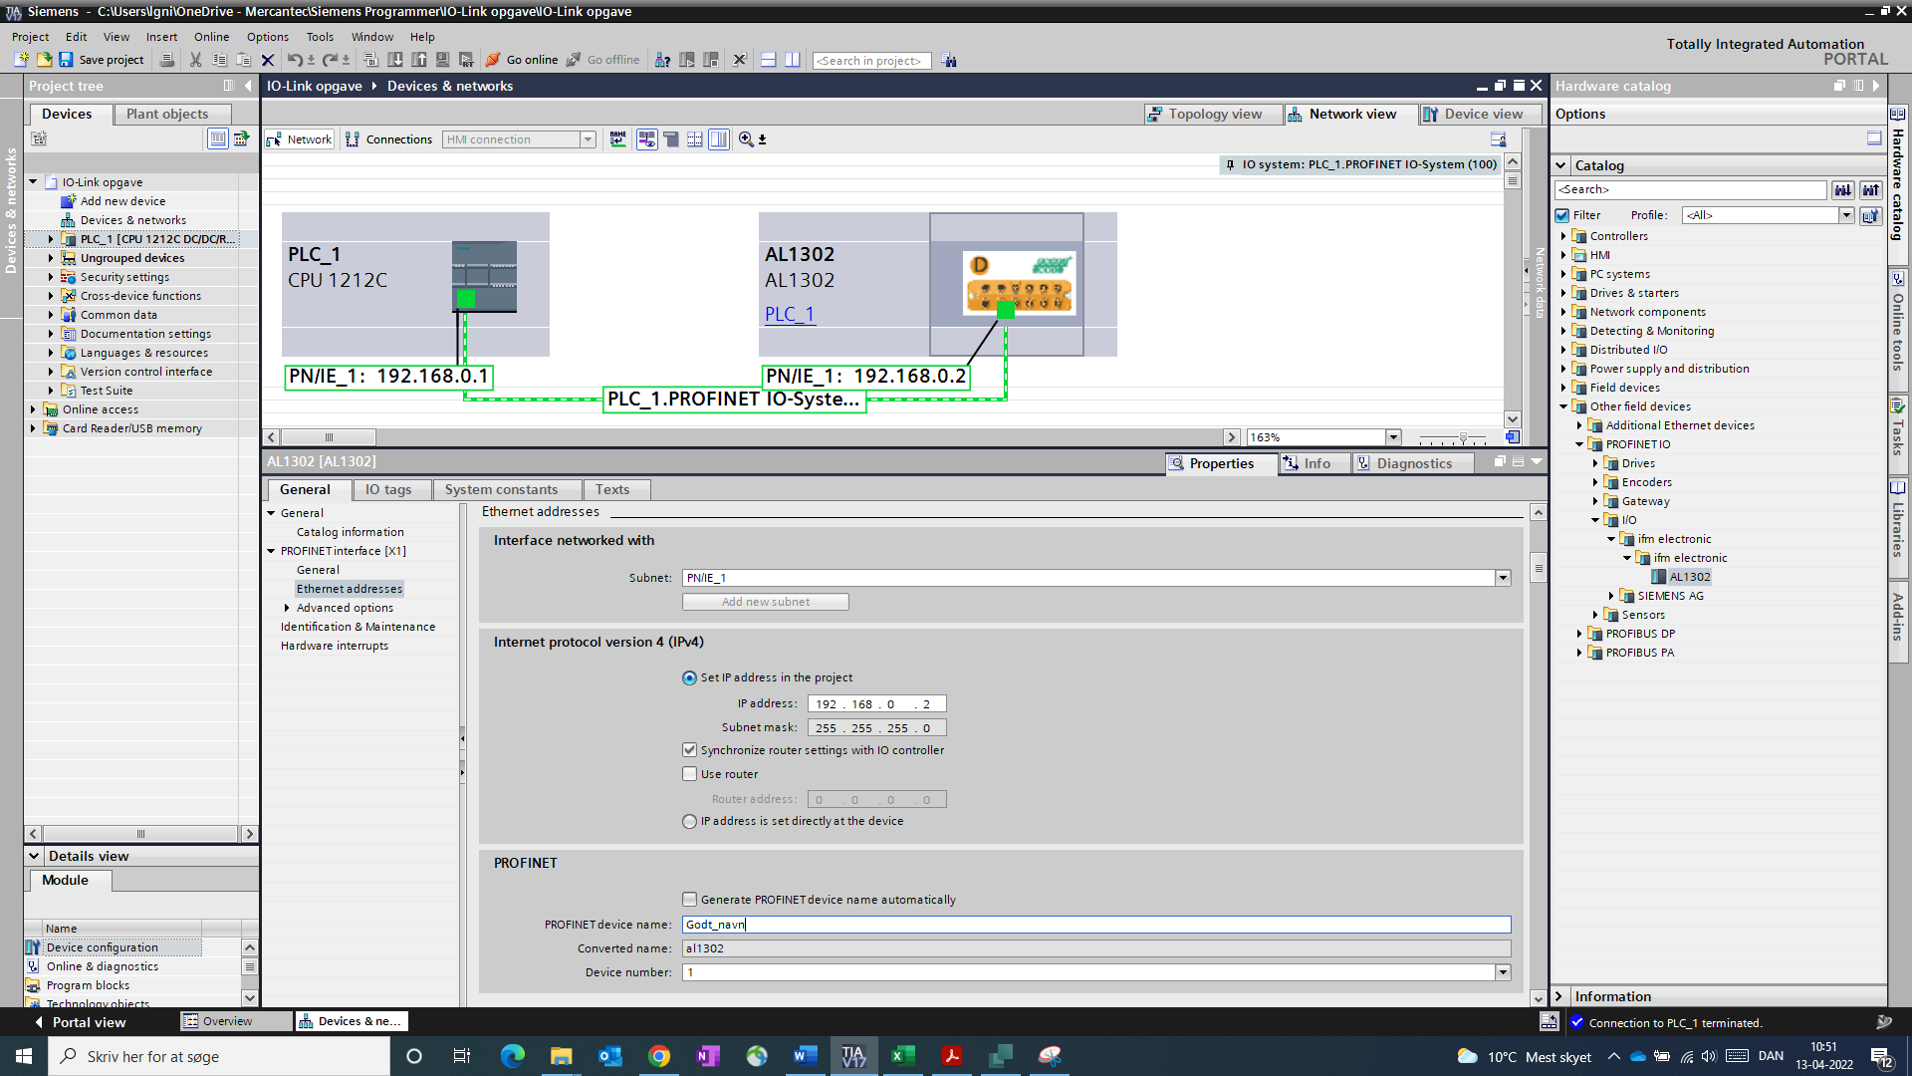
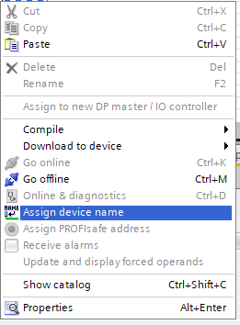
IO Link
TIA setup
When the IO master is installed in TIA:
Add master in "network view“
Establish connection to PLC.
Checking the IP add.
Change the IP add, if necessary.
Enter Device name.
Transfer to PLC
Assign Device name
6
3
2
1
4
7
5

Slide 17
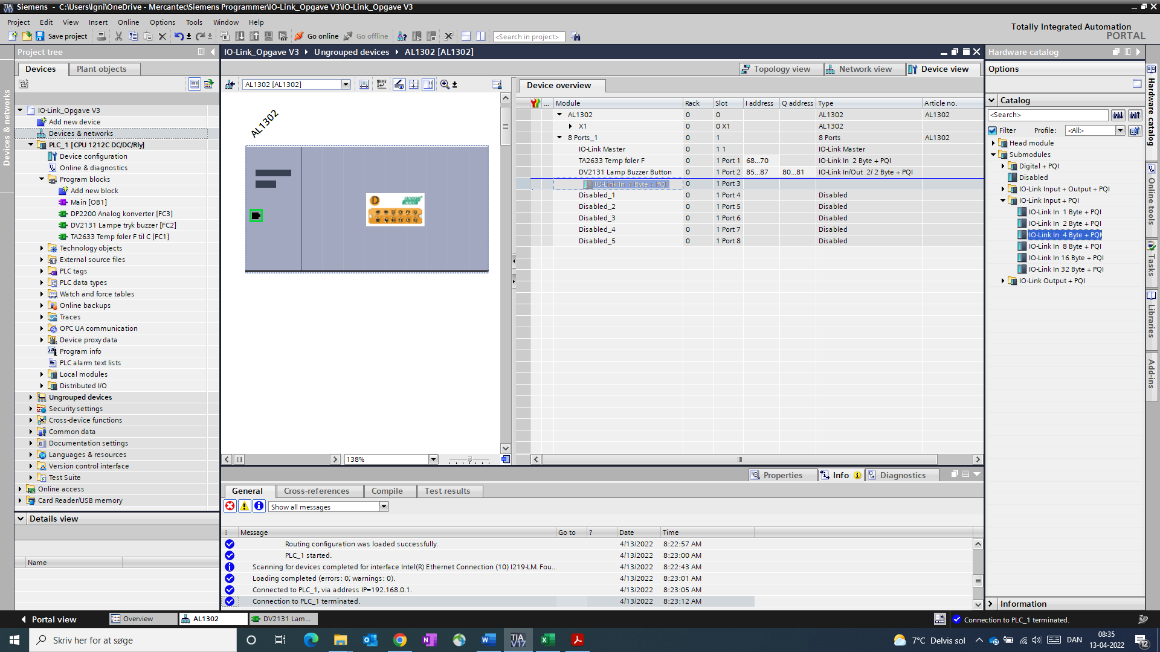
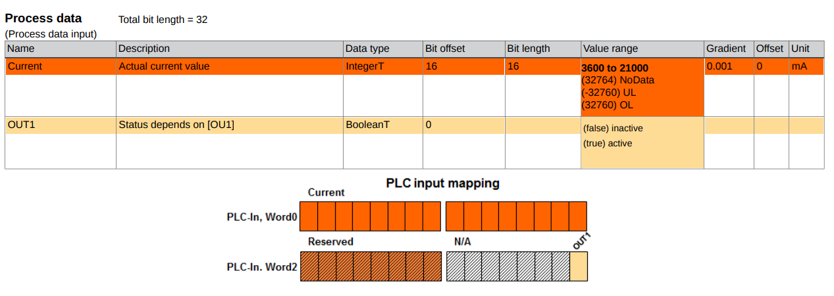
IO Link
TIA Setup
Configuring the master:
On the ports, I/O data must be assigned
The amount must fit the device connected to the port
For IFM devices you can see it in an "IO device description pdf"
It can be found on IFM's website
"IO device description pdf"

Slide 18
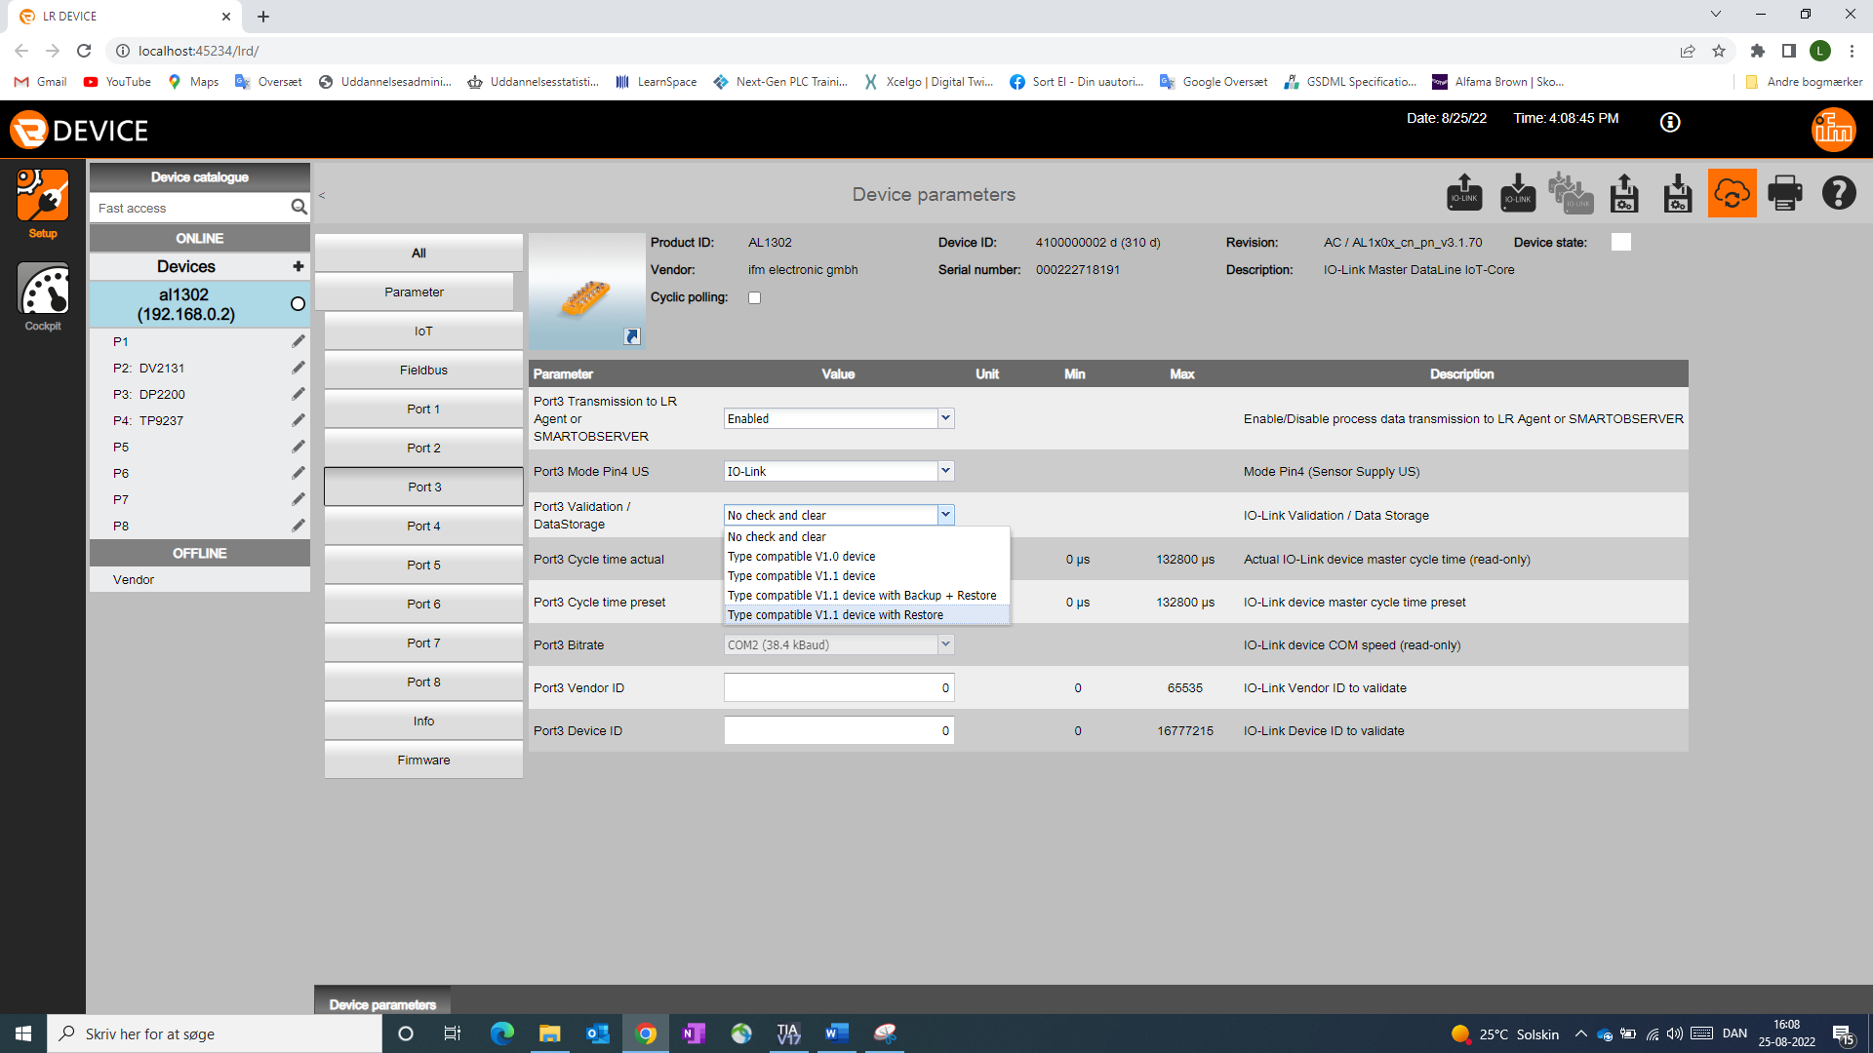
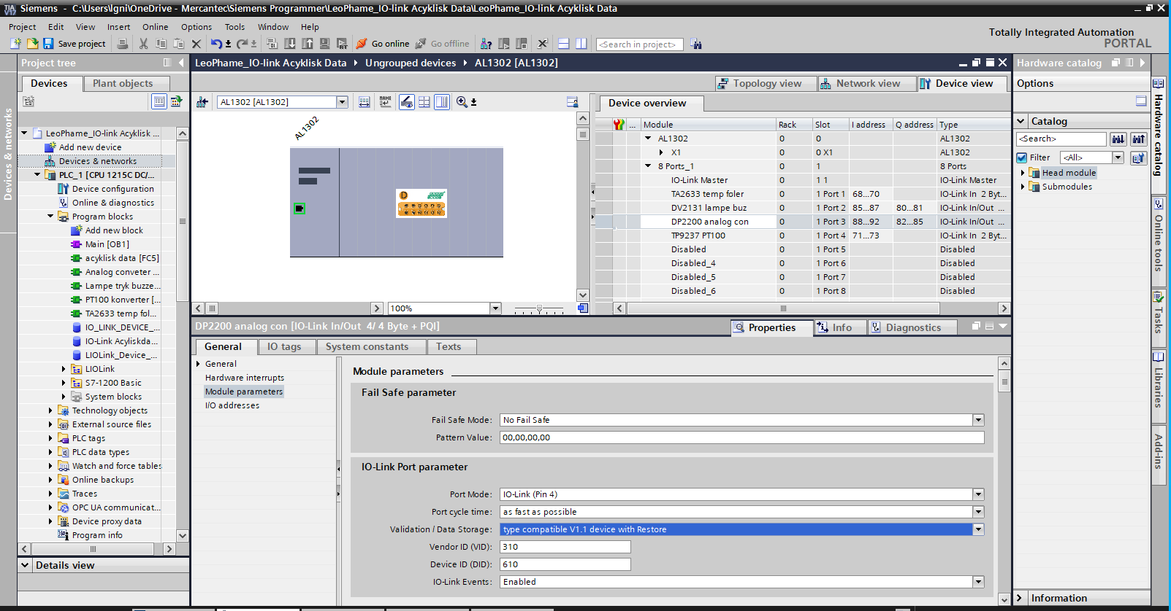
IO Link
IFM Port Validation / Data Storage
Possible choices | Validation of the IO-Link device | Storing the parameter values | Restoring the parameter values | Recommended use
[No check and clear] | none | none | none
[Type compatible V1.0 device] | yes, test the compatibility with IO-Link standard V1.0 | none | none
[Type compatible V1.1 device] | yes, test the compatibility with IO-Link standard V1.1 | none | none | Operation of systems on ports where calibration of measurement values ​​is critical.
[Type compatible V1.1 device with Backup + Restore] | yes, test the compatibility with IO-Link standard V1.1 and the design identity (vendor ID and device ID) | yes, automatic storing of the parameter values. changes to the current parameter values ​​will be saved automatically | yes, restoring the parameter values ​​when connecting an identical IO-Link device with factory settings | when commissioning the system on ports where calibration of measuring media is not critical.
[Type compatible V1.1 device with Restore] | yes, test the compatibility with IO-Link standard V1.1 and the design identity (vendor ID and device ID) | no, there are no automatic storage changes of the current parameter values. values ​​will not be saved | yes, restoring the parameter values ​​when connecting an identical IO-Link device with factory settings | when operating systems on ports where calibration of measurement values ​​is not critical.
Connected type check based on ID and Vender codes
Backup and Restore when replacing defective device
More options
Choice depends on needs
Can be activated
Via LR-DEVISE
Via PLC (which is then controlling)

Slide 19
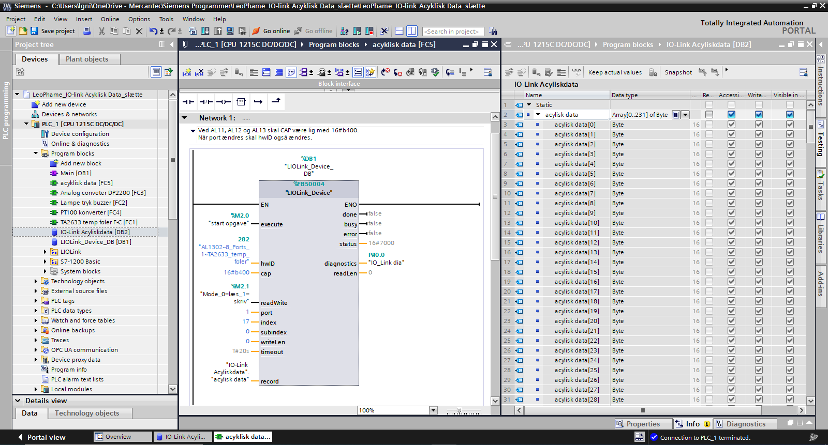
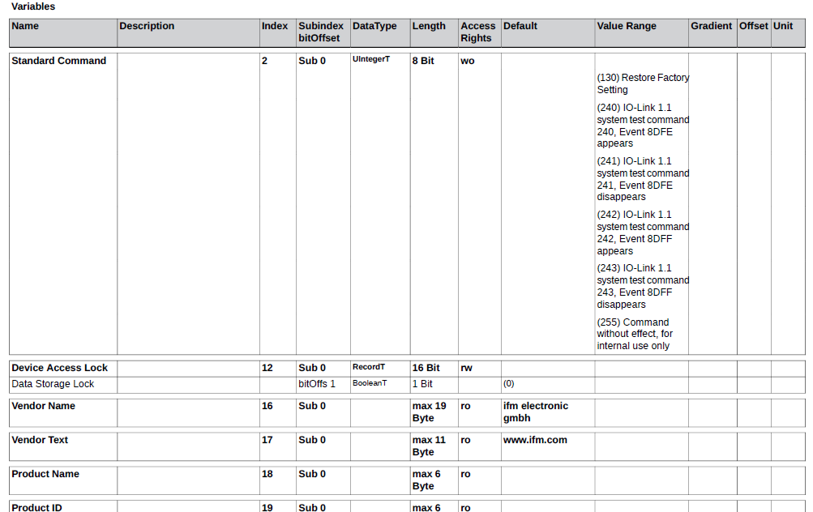
IO Link
Acyclic data using FB50004 IO_LINK_DEVICE
Simens has developed a standard function block that can be used when reading and writing acylic data from an IO-Link device
The leg cap must be assigned the value 16#b400 for IFM master AL 13xx...
The example reads
"Index" 17, "Subindex" 0.

Slide 20
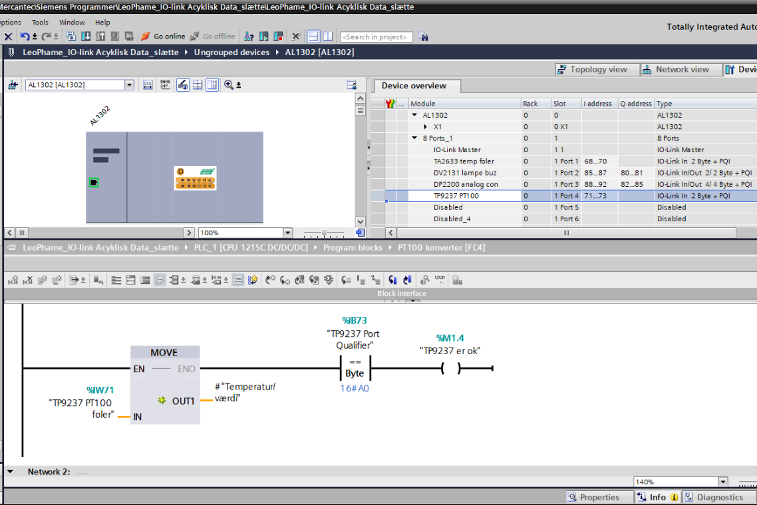
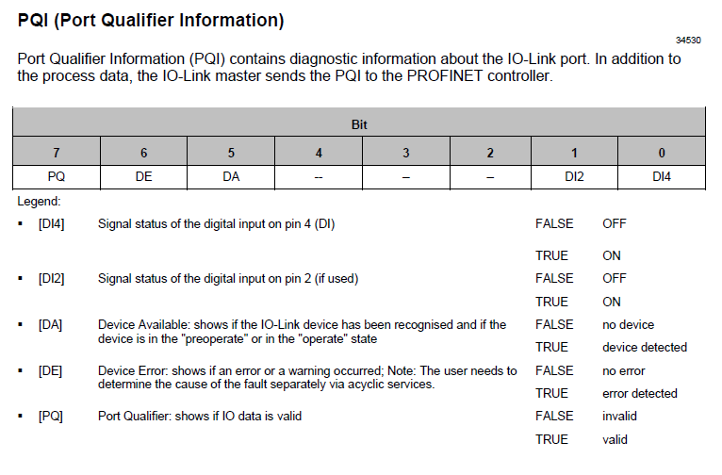
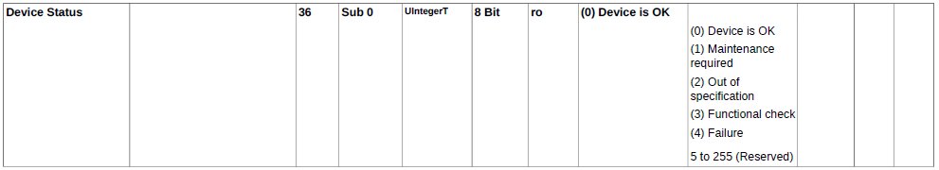
IO Link
TIA Port Qualifier Input and Index 36
Use when:
You want to know if the value you are loading from an IFM IO-Link sensor is okay or if the sensor is connected to the master.
IB71 and 72, like IW71, are used to store the measurement value.
IB73 is "PQI" port qualifier input byte.
A0hex is 1010 0000bin - that is, bit 7 and bit 5 are TRUE
Index 36?:
explain why PQ is off
Notes:
NOTE: In most IFM components, it is in Index 36, NOTE: In most IFM components, it is in Index 36 that Device Status is stored.

Slide 21
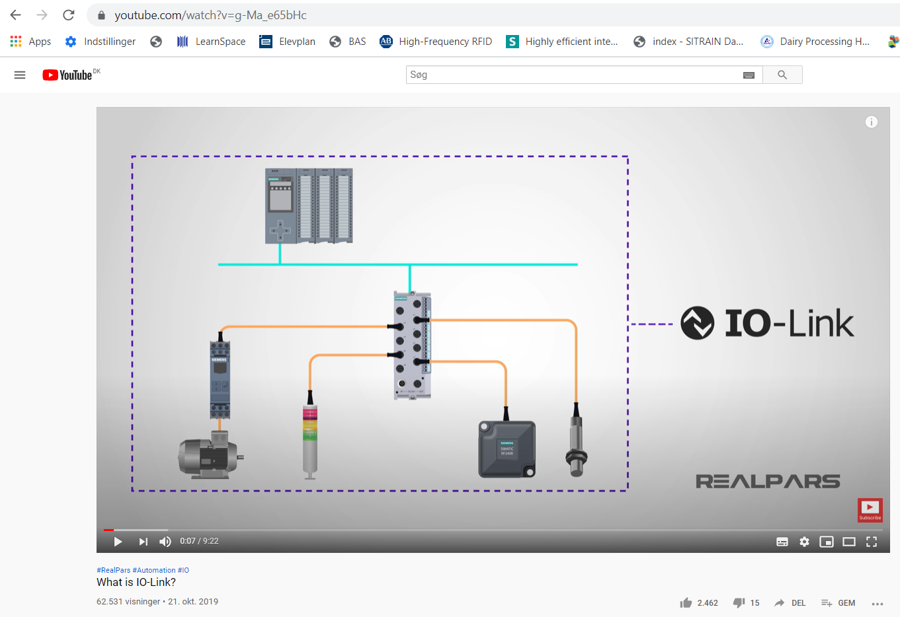
I/O Link
What it is
Good video that simply explains the main points.
https://www.youtube.com/watch?v=g-Ma_e65bHc
Thorough, geeky and long video.
"A bit boring and electronics embossed"
https://www.youtube.com/watch?v=_JxLmz-g2XM&feature=emb_rel_end

